Slide 1
Combating Hate Crimes
Devin El-amin

Slide 2
Hate crime facts: Youthful Hate crime
33% of all known hate crime offenders are under 18.
31% of all violent crime offenders and 46% of the property offenders are under 18.
29% of hate crime offenders are 18-24.
30% of all victims of bias-motivated aggravated assaults and 34% of the victims of simple assault are under 18.

Slide 3
2010 Hate crimes: Bar graph

Slide 4
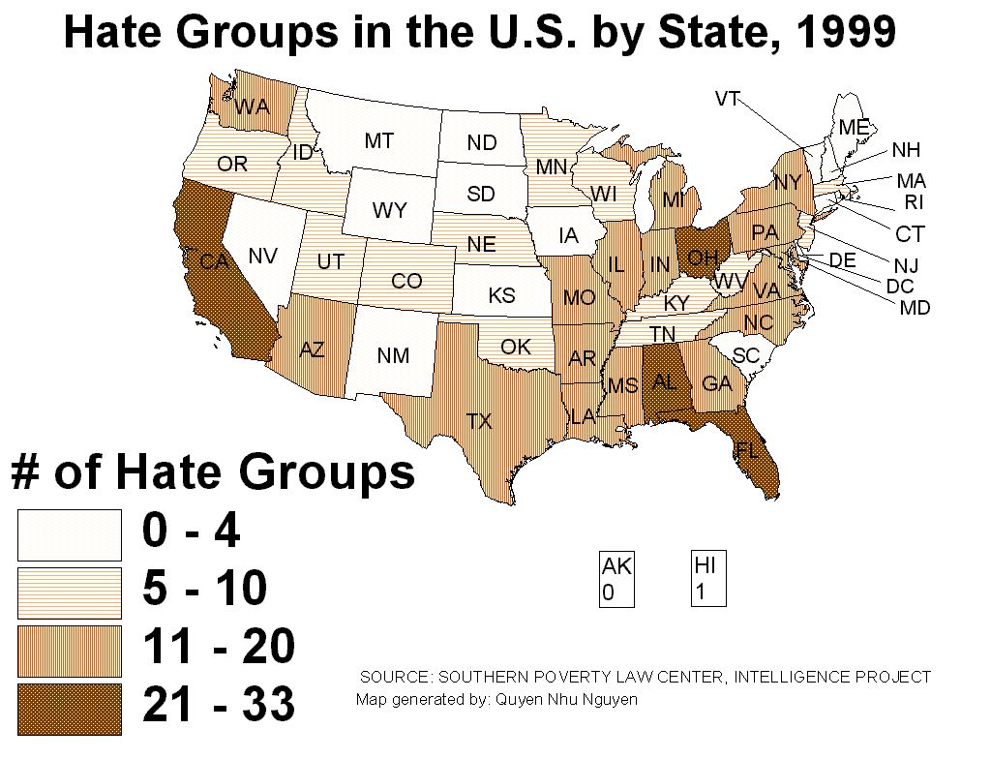
Hate groups in the U.S

Slide 5
Total Reported FBI Hate Crimes,1997-2008
Year | Anti-Hispanic | Anti-Jewish | Anti-Muslim | Anti-Black | Anti-Male Homosexual
2008 | 735 | 1055 | 105 | 3413
2007 | 775 | 1010 | 133 | 3275
2006 | 770 | 1027 | 191 | 3136
2005 | 660 | 900 | 146 | 32oo
2004 | 611 | 1003 | 193
2003 | 529 | 987 | 155
2002 | 601 | 1039 | 170
2001 | 755 | 1117 | 546
2000 | 735 | 1161 | 33
1999 | 576 | 1198 | 34
1998 | 595 | 1145 | 23
1997 | 636 | 1159 | 31

